Slide 1
Courier Management System
Team-10
TEAM-10 2410030016 –Gayathri
2410030476-Dakshayani 2410030455-Akshitha 2410030492-Keerthi
2410030119-Mahendra

Slide 2
Table:
Introduction
Feasibility analysis
societal needs
conclusion

Slide 3
Introduction The Courier Management System is a simple and efficient way to manage the process of sending and receiving parcels. It helps users create shipments, track their status, and keep a record of all deliveries. This system connects Senders, Couriers, and Recipients to ensure smooth and timely delivery of packages.
Key Objectives:
📦 Easily create and manage shipments
📍 Track parcel status in real time
📝 Keep proper logs of delivery updates
🤝 Improve communication between users and delivery staff
⏱️ Save time and reduce delivery mistakes

Slide 4
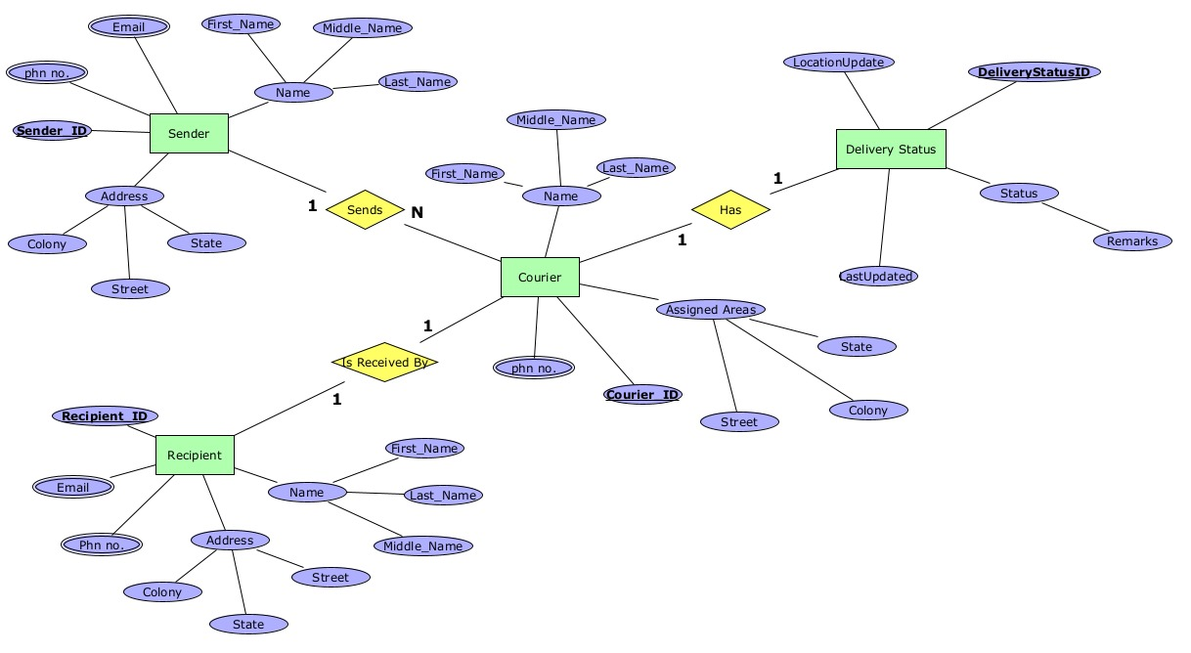

Slide 5
Feasibility Analysis
Before starting a project, we need to check if it is possible to build and if it is affordable. This Courier Management System is easy to make and not too costly. It uses simple tools and works well for many users.
✅ Technical Feasibility:
Can be made using simple computer tools (like websites and databases).
Works on both computers and mobile phones.
Can be improved or updated later.
Can connect with SMS or email alerts.
💰 Economic Feasibility:
Costs less to build using free tools.
Saves money by reducing paperwork.
Needs fewer workers to manage parcels.
Good for small shops and big courier companies.

Slide 6
Application to Societal Needs
The Courier Management System helps solve real-life problems related to delayed, lost, or untracked parcels. It makes parcel services more trustworthy, especially for small businesses and people in remote areas. This system supports faster and more reliable deliveries.
How it helps society:
📦 Saves time by showing real-time parcel status.
📍 Helps people in villages and towns get better delivery services.
🏪 Supports small shops and online sellers to manage deliveries easily.
💊 Can be used to deliver important items like medicines or documents.
📲 Improves communication between sender and receiver.
♻️ Reduces paper use by storing data digitally.
⚠️ Reduces delivery mistakes by keeping proper records.

Slide 7
Conclusion
The Courier Management System is a simple and helpful tool. It makes it easy to send and receive parcels. Users can book shipments and track them online. The system shows where the parcel is and when it will arrive. This saves time and avoids delivery mistakes. It keeps all parcel records safe and organized.
This system is useful for courier companies, small businesses, and customers. It helps businesses manage their deliveries better. Customers also get regular updates about their parcels, which improves their trust. The system is not expensive and is easy to build. It works well on computers and mobile phones.
In the future, more features can be added to make it even better. This system helps solve real delivery problems and makes courier services faster and more reliable for everyone.

Slide 8
Thank you

